Slide 1
Computer vision driving aids an adaptation of adas to the android platform
Traffic sign recognition
Lane departure detection and warning
Collision and obstacle avoidance
Notes:
Adam

Slide 2
Team members
Belorkar, Sapana Senior Quality Assurance Engineer, Insurance Industry
Burbidge, Adam (Team Leader) Systems/Software Engineer, Pratt & Whitney
Roseberry, Keith Software Technical Fellow, UTC Aerospace Systems
Varadaraju, Rakshith Software Engineer, Rockwell Collins
Notes:
Adam

Slide 3
Project overview
Using an Android Mobile Phone or a Raspberry Pi 3 B+ and a camera module, develop computer vision processing to perform the following functions
Project will attempt one or more of:
Collision and Obstacle Avoidance: Detect obstacles in the path of the vehicle to predict collisions and warn the operator.
Traffic Sign Recognition: Read traffic signs, most importantly speed limit signs, to determine appropriate driving behavior.
Lane Departure Detection and Warning: Determine when the vehicle is departing from its travel lane and warn the operator. Requires recognition of a travel lane.
Notes:
Adam

Slide 4
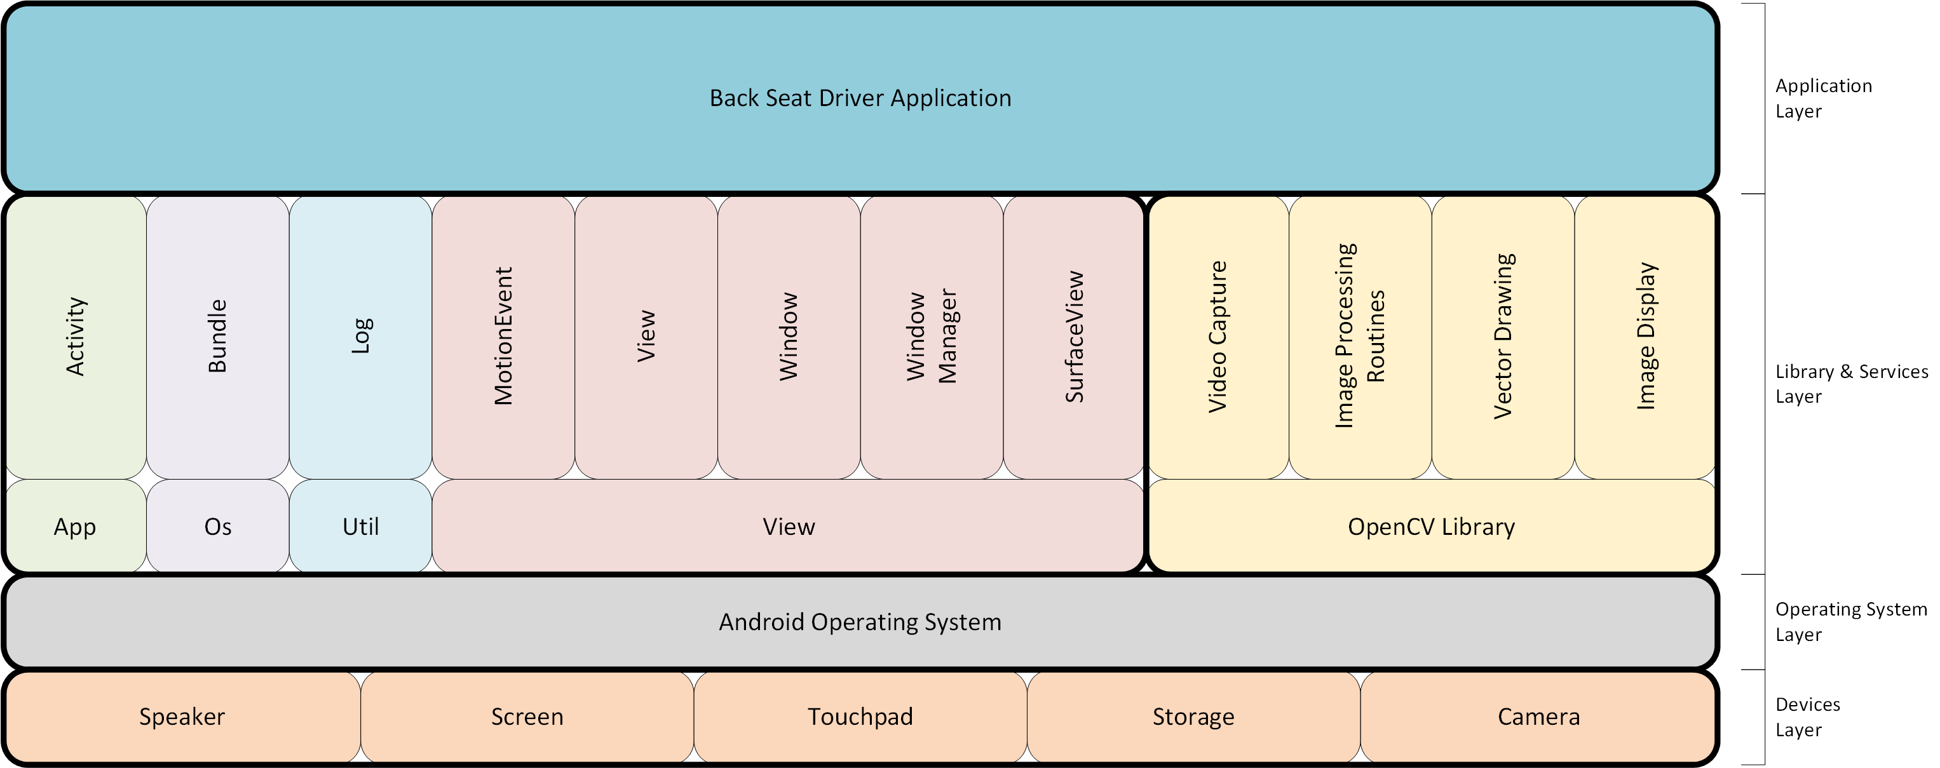
Software Architecture – logical view
Notes:
Keith

Slide 5
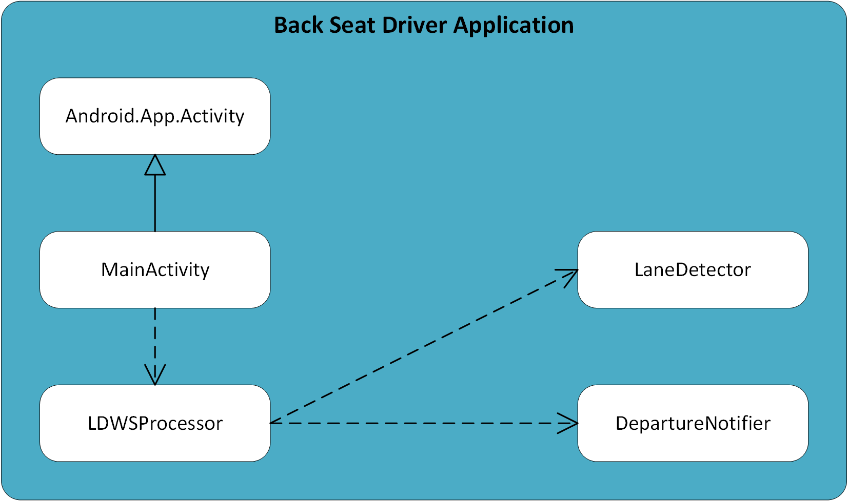
Software Architecture – logical view
Notes:
Keith

Slide 6
Software architecture - goals
Extensibility
MainActivity invokes additional "processor" classes
Modularity
Partitioning of the major sub-functions of the application functionality into separate classes
Team members work independently on the classes.
Performance
Streamlining of the processing into a serial/pipeline methodology
MainActivity invokes the LDWSProcessor class
LDWSProcessor invokes the LaneDeparture class
LDWSProcessor invokes the DepartureNotifier class

Slide 7
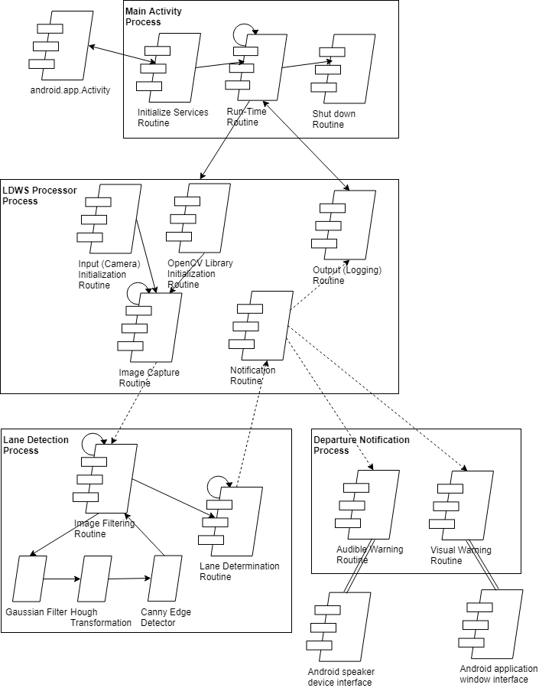
Software Architecture – process view
Notes:
Keith

Slide 8
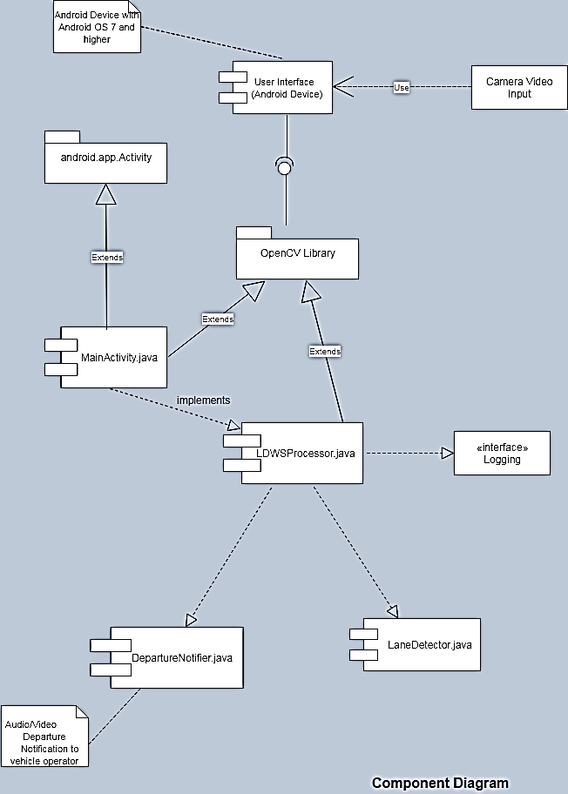
Software Architecture – development view
Notes:
Sapana

Slide 9
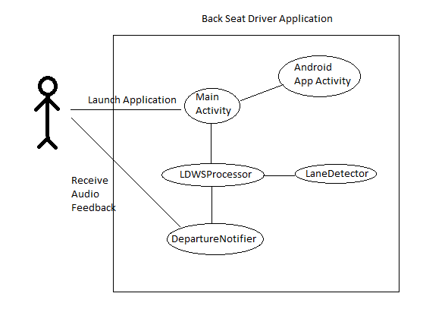
Software Architecture – scenarios
Normal Operation
Launch Application
Application monitors for lane departure
Application alerts user when car is close to leaving the lane
User closes application at end of trip
Lane Departure Alert
Launch Application
Application monitors for lane departure
Application detects lane departure
Application triggers audio alert
Application continues to monitor next lane departure
Notes:
Keith

Slide 10
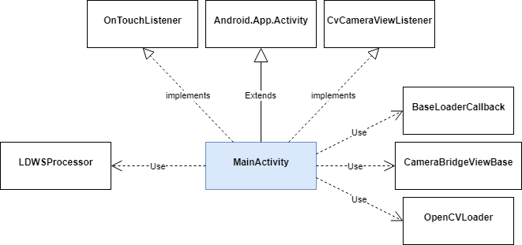
MainActivity Class

Slide 11
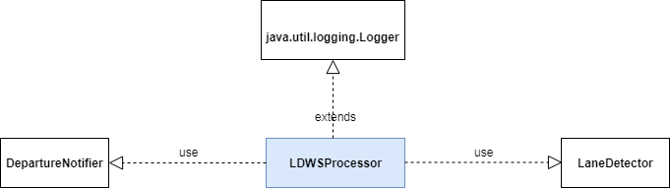
ldwsprocessor Class

Slide 12
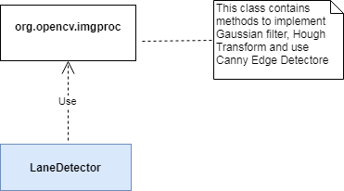
lanedetector Class

Slide 13
departurenotifier Class
TBD

